Slide 1

Media and information Literacy and Cyberbullying
A presentation by:
Arturo, Huub, Hyeon, Leah, Liam and Min

Slide 2
Table of contents
Bullying | Content | Game
Cyberbullying | Target Audience | Our game
Media and information literacy | Story | Technical specifications

Slide 3
Cyberbullying

Slide 4
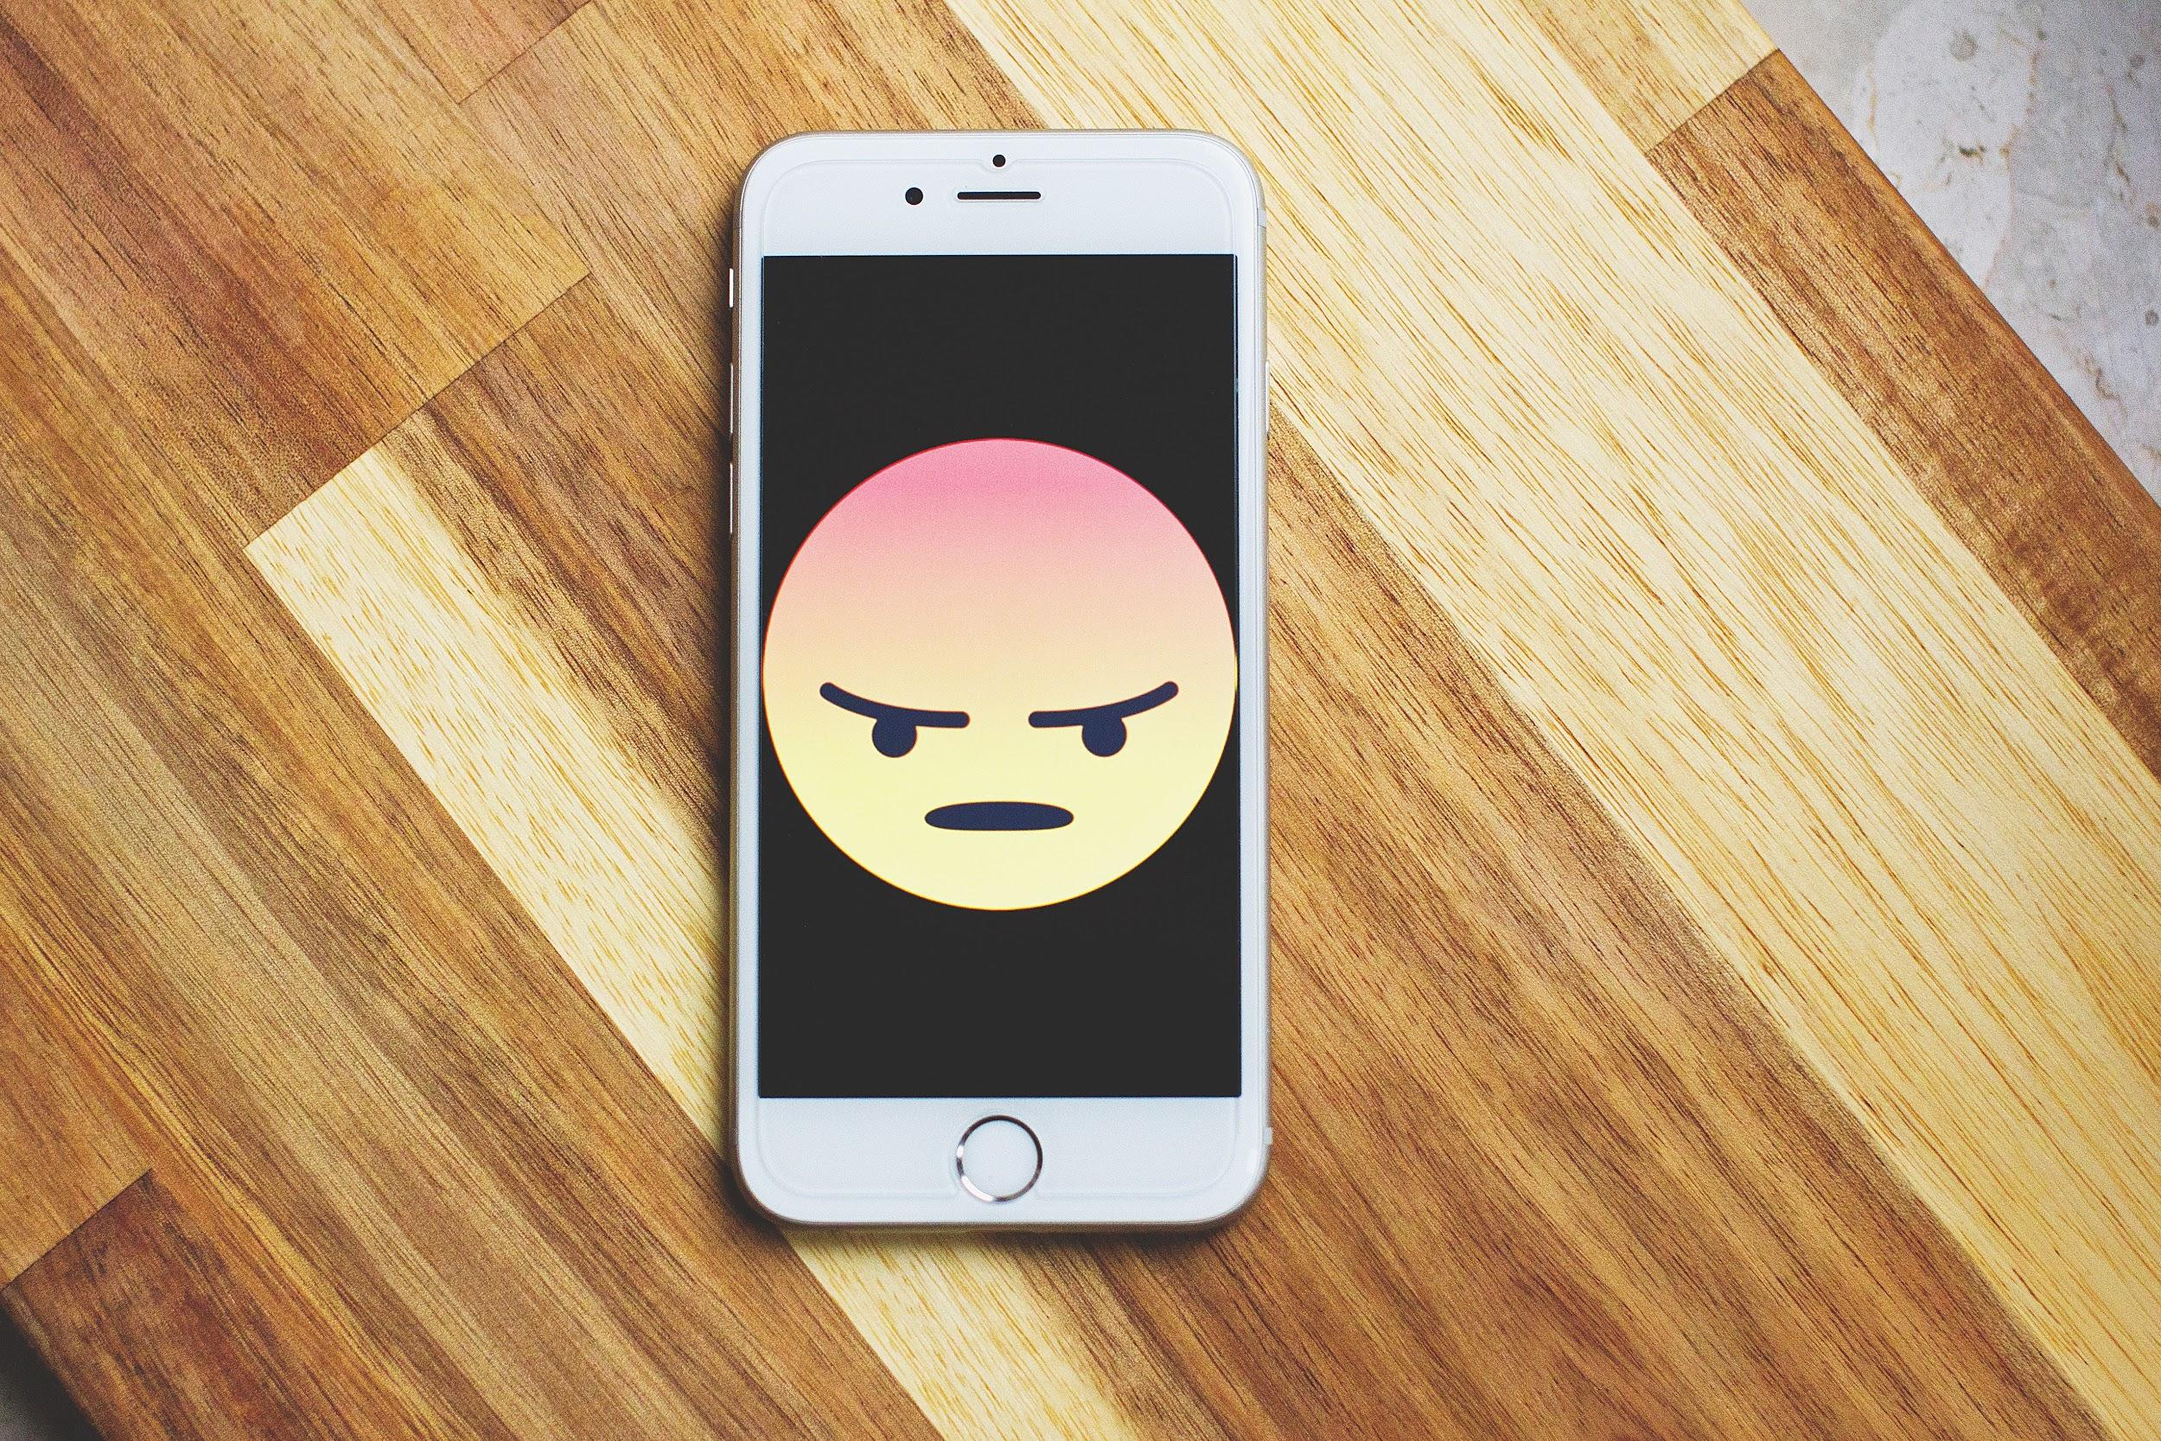

Slide 5
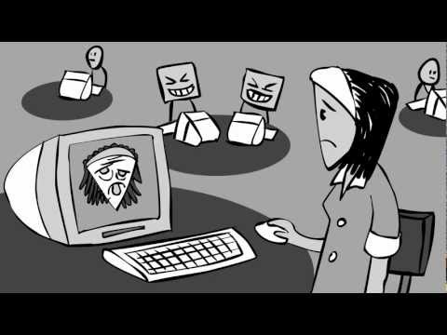

Slide 6


Slide 7

Notes:
Freedom of speech
Freedom of expression
Cyberbulling is a violation of one of those things.

Slide 8
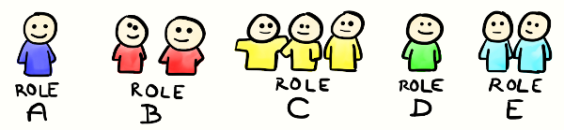
Notes:
Freedom of speech
Freedom of expression
Cyberbulling is a violation of one of those things.

Slide 9
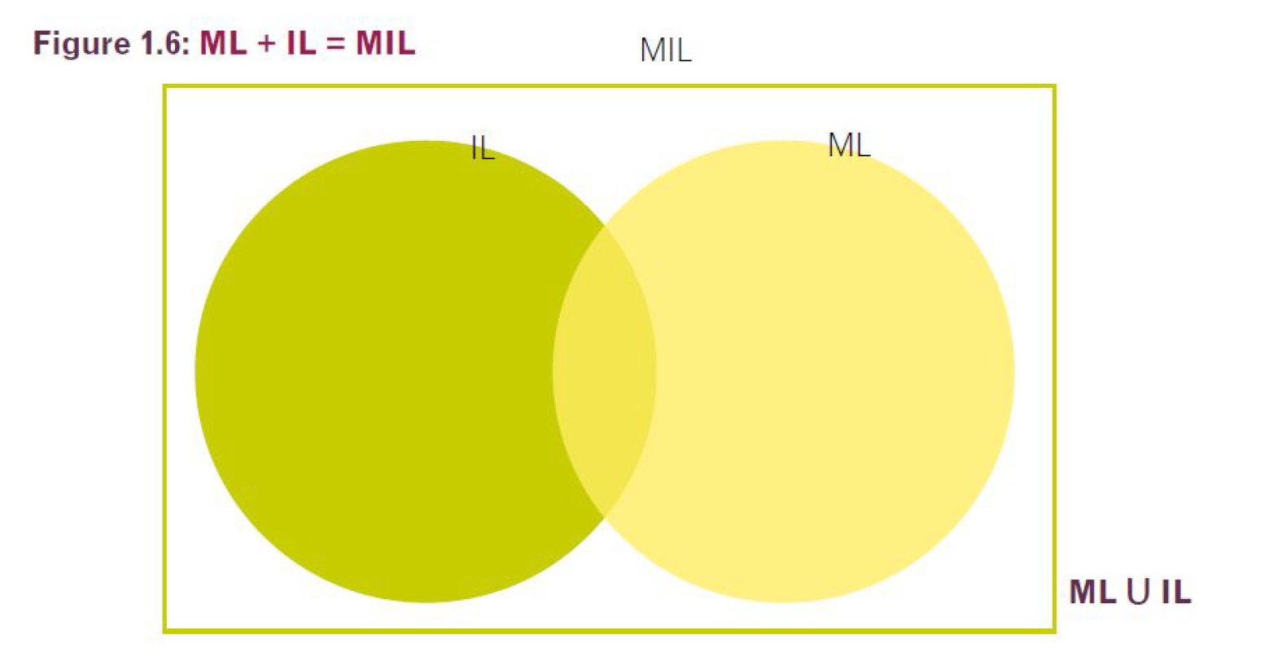
Definition
debate
Notes:
Until this day there is still debate between Information Litery and Media information literacy

Slide 10
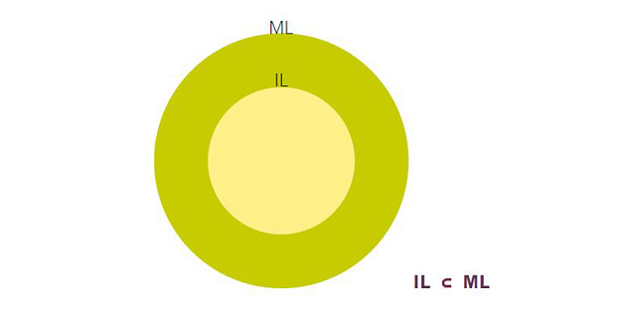
Definition
debate
Notes:
Until this day there is still debate between Information Litery and Media information literacy

Slide 11

Notes:
Media literacy
Modern media
Computers
Mobile devices
Smart devices
Teachers can give guidance on giving information
What is your favorite device?

Slide 12

Notes:
Furthermore,individuals with knowledge on this matter, can analyze information, messages,
beliefs and values conveyed through the media and any kind of content producers, and can
validate information they have found and produced against a range of generic, personal and
context-based criteria. In addition, an understanding in who created the information and why
it is important, as well as the roles, responsibilities and functions of media, information
providers and memory institutions, is mandatory. (

Slide 13

Netiquette

Slide 14
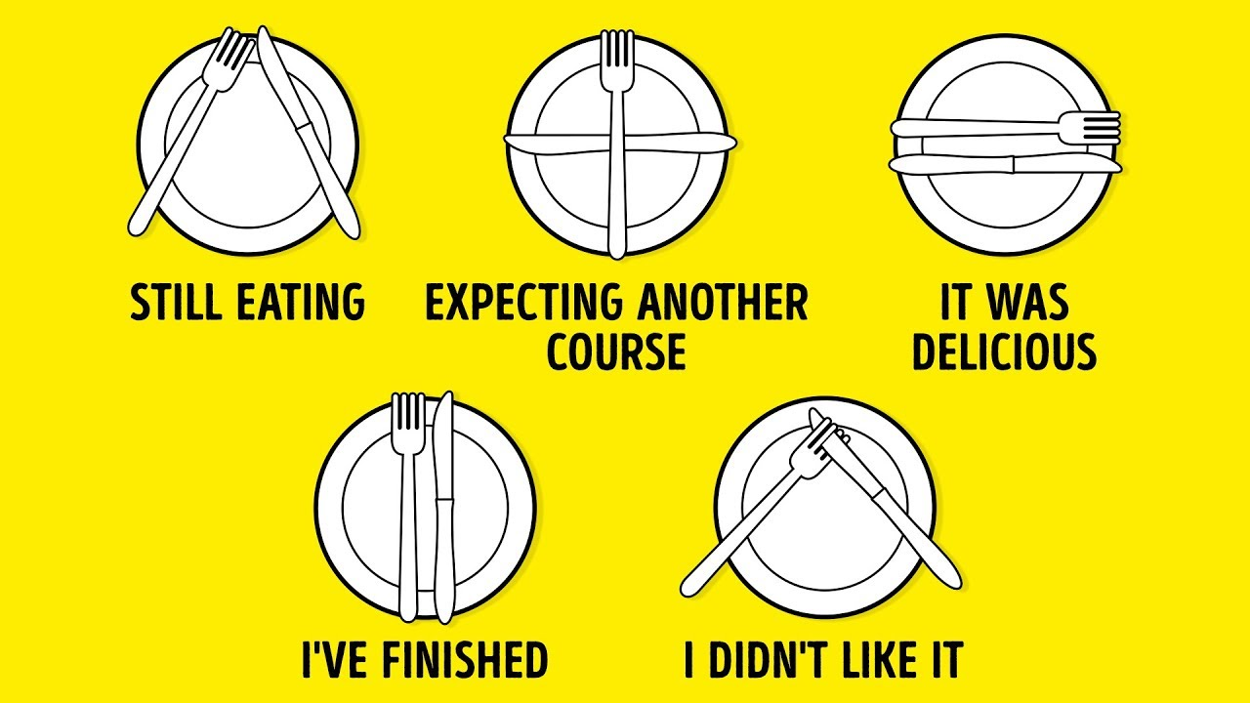

Slide 15
Target Audience
Notes:
i will talk about our target group. Teenagers grow up with digital-technology, so it easier for them to bully other people online. In fact, 95% of the students between 10 and 18 years has mobile phone or their own SNS. Now that a wider variety of social media platforms and digital-devices are operative victims will more frequently be harassed.

Slide 16
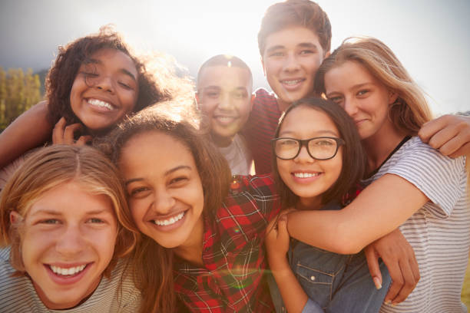
Students
13-15
Notes:
So, our target group is teenagers, especially between the ages of 13 and 15. They are pupils someone who are learning at a school. It is time for self-identity to grow and learn about social life. Their responsibility is to play the game and get a knowledge about cyberbullying. The success criteria of them is that children clear each stage and understand what cyberbullying is and aware of the dangers of cyberbullying.

Slide 17

Teachers

Slide 18
Story

Slide 19

Notes:
So, i will talk about our target group. Teenagers grow up with digital-technology, so it easier for them to bully other people online. In fact, 95% of the students between 10 and 18 years has mobile phone or their own SNS. Now that a wider variety of social media platforms and digital-devices are operative victims will more frequently be harassed.

Slide 20

Notes:
So, i will talk about our target group. Teenagers grow up with digital-technology, so it easier for them to bully other people online. In fact, 95% of the students between 10 and 18 years has mobile phone or their own SNS. Now that a wider variety of social media platforms and digital-devices are operative victims will more frequently be harassed.

Slide 21
Our Game

Slide 22
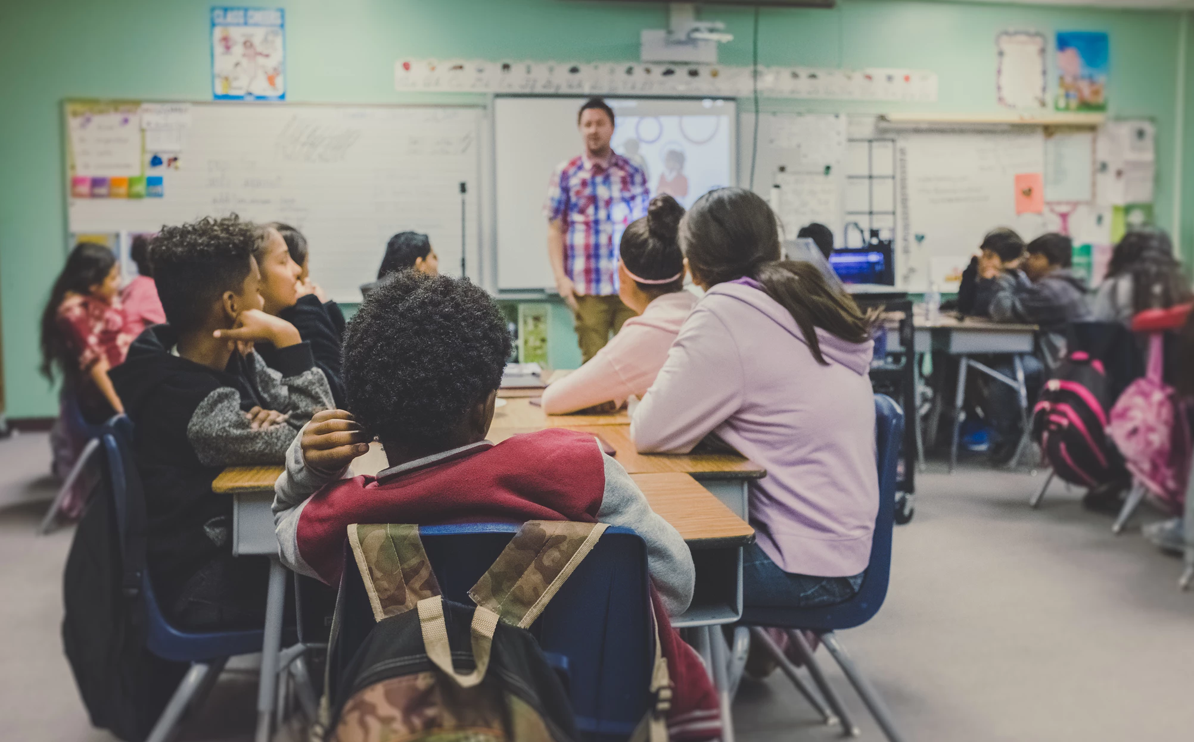

Slide 23
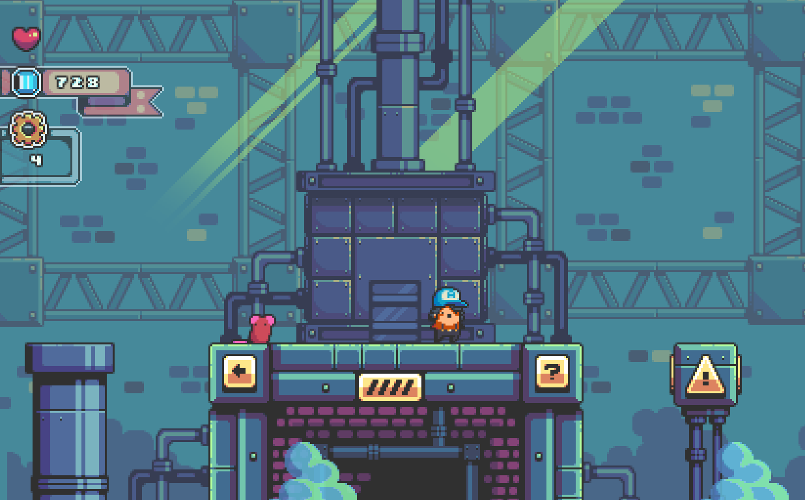

Slide 24
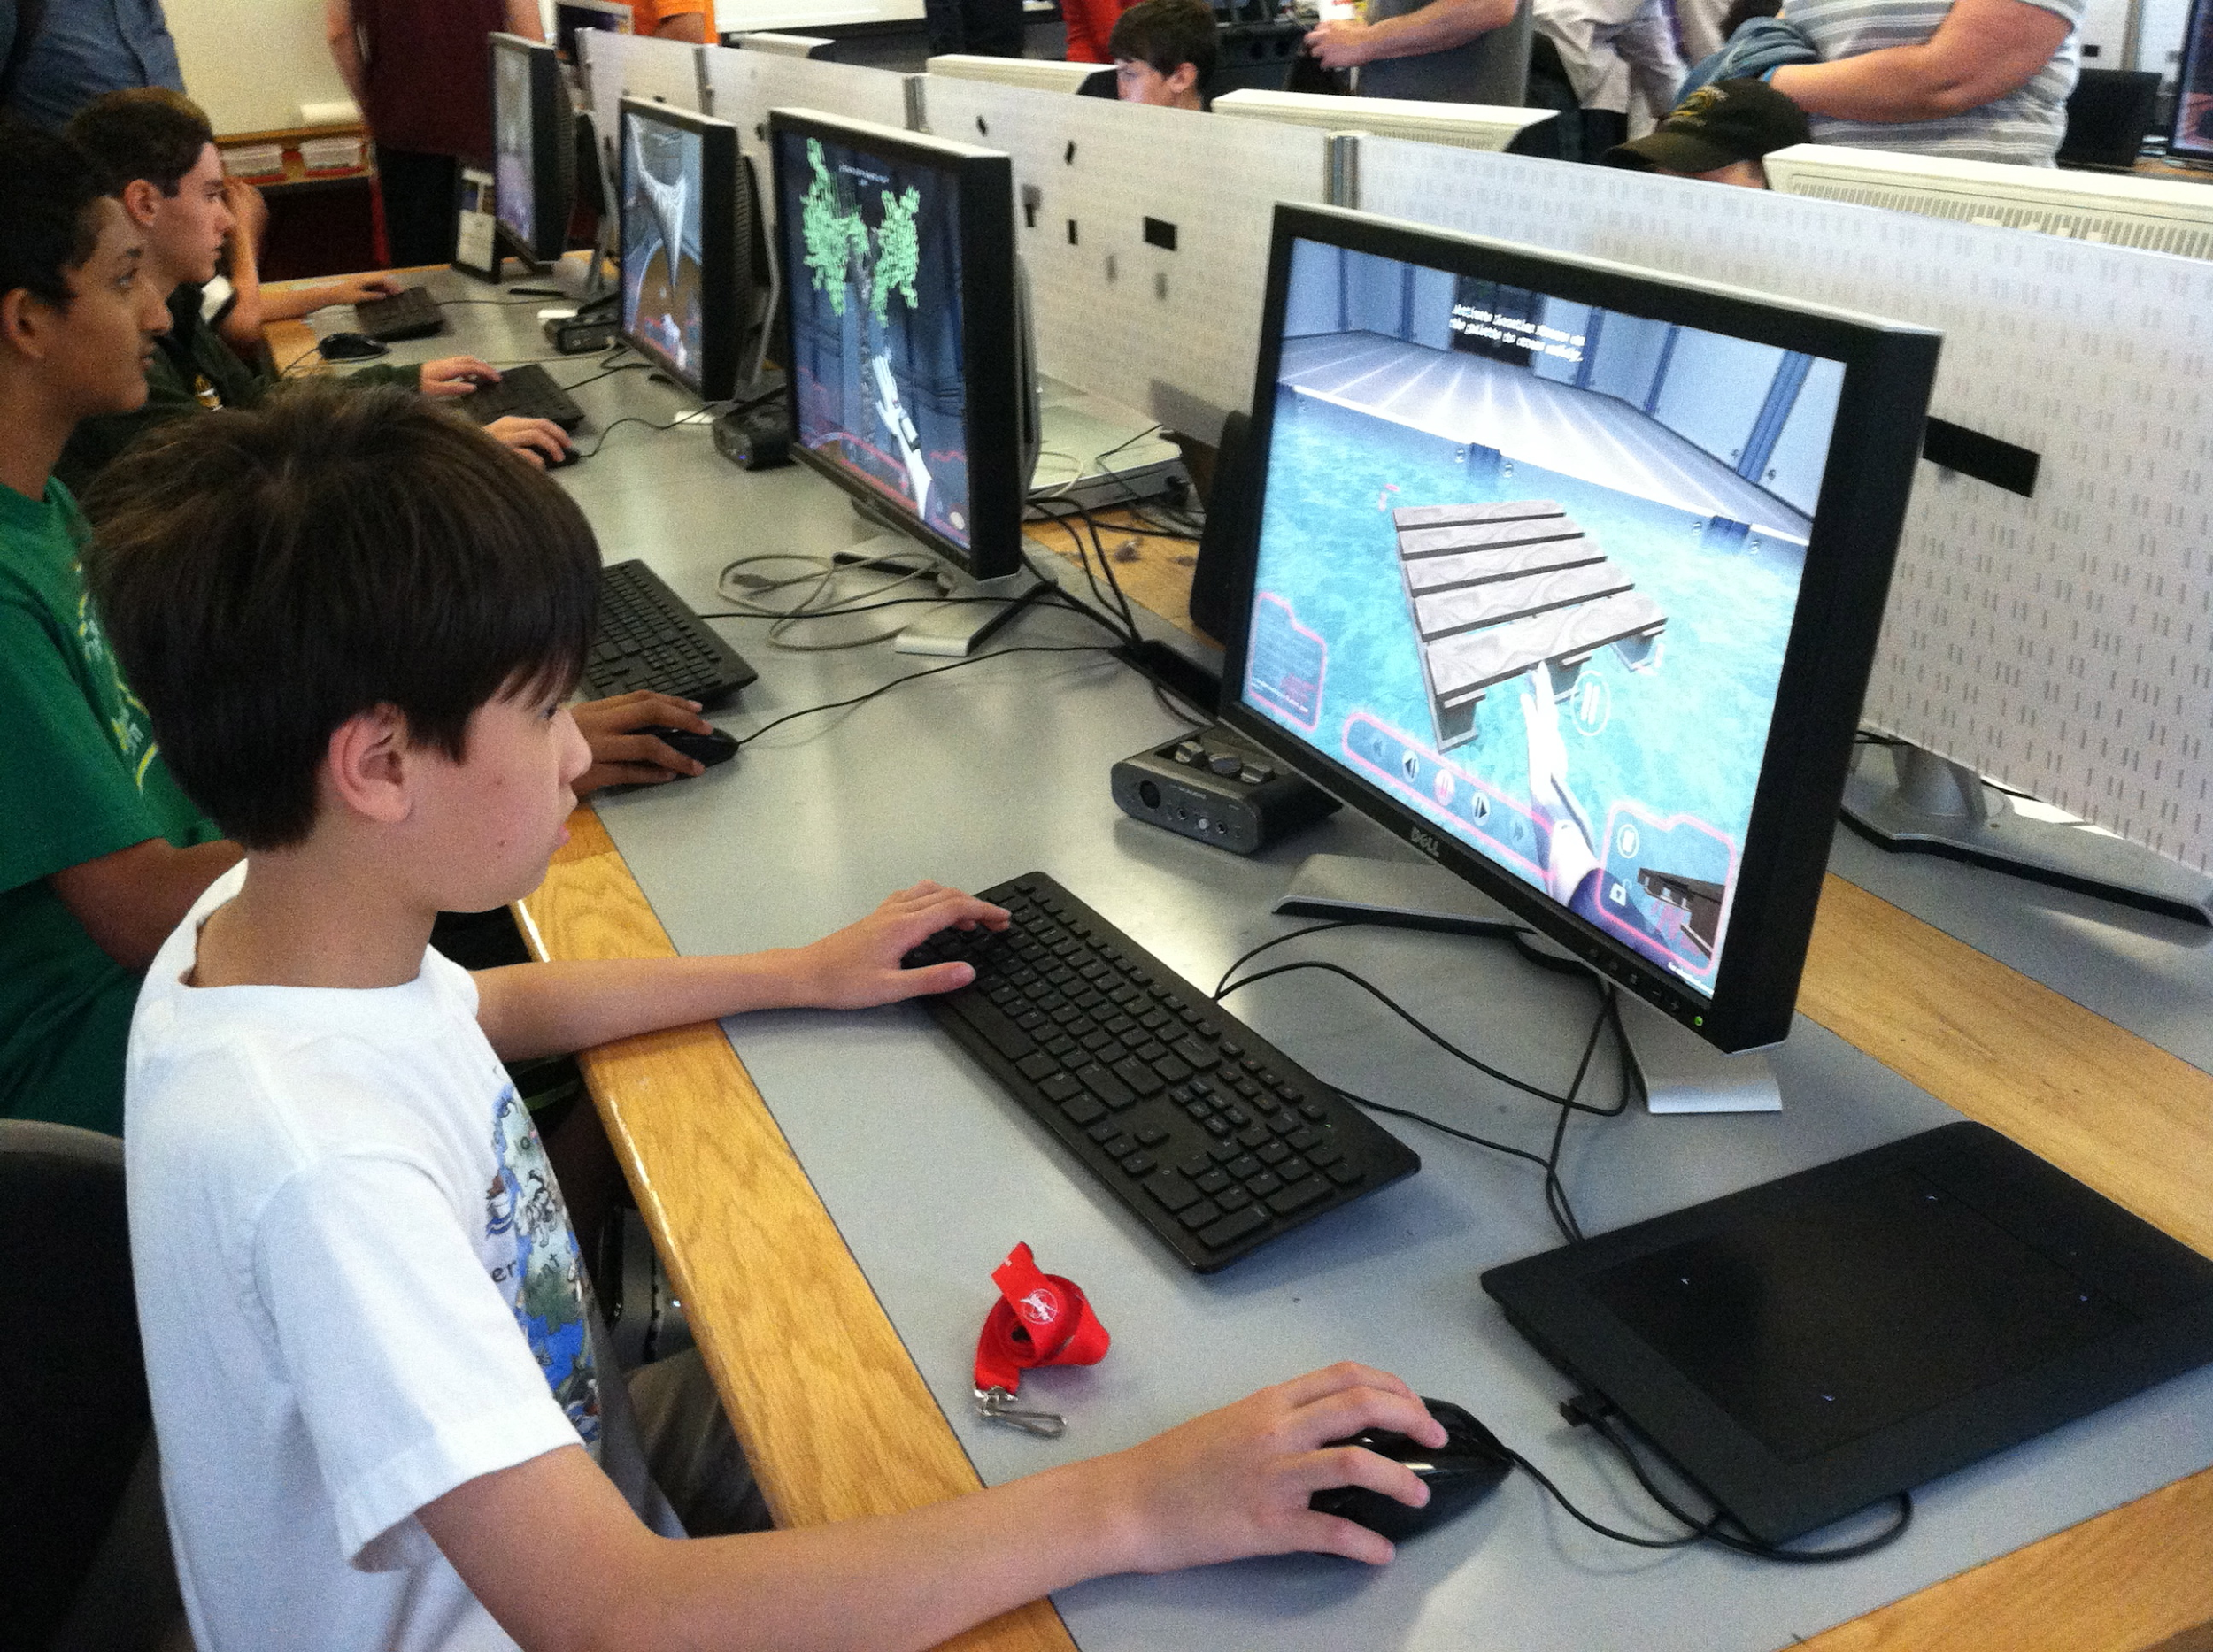

Slide 25
Technical Specifications

Slide 26


Slide 27


Slide 28


Slide 29

Notes:
hosting

Slide 30
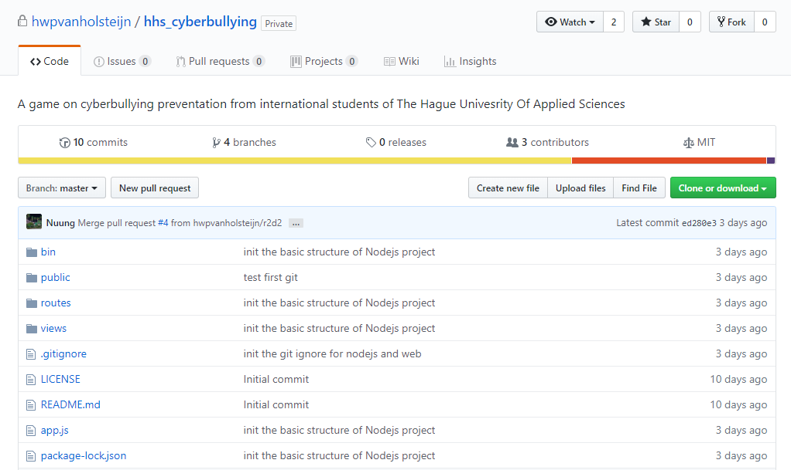


Slide 31
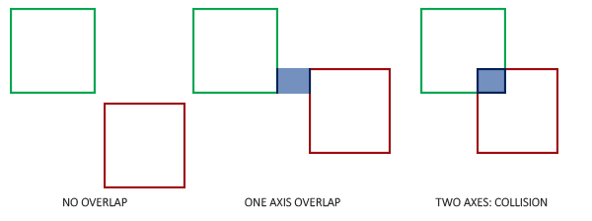



Slide 32
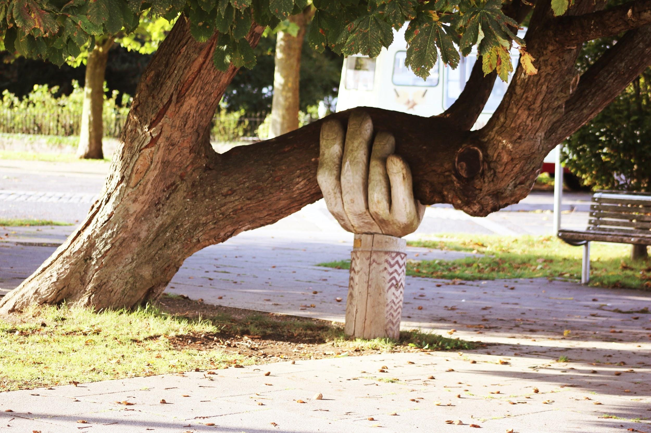

Slide 33


Slide 34
Bibliography
Cole, J. (2016, April 15). Are You Teaching Good Netiquette? Retrieved 12 April 2019, from TeachOnline website: https://teachonline.asu.edu/2016/04/teaching-good-netiquette/
Google Africa. (2012). Cyber Bullying (UNICEF). Retrieved from https://www.youtube.com/watch?v=asTti6y39xI
Holsteijn, H. van, Jeong, H. W., Lee, J., Sandoval Rodríguez, A. I., & Voyle, L. (2019). Cyberbullying prevention. 24.

